Slide 1

Course Enrollment System
David Ashby
The University of Arizona Global Campus
CST 499: Capstone Computer Software Technology
Instructor Amr Elchouemi
9/26/2022

Slide 2

Objective
Summarize key aspects of the Software Requirements Specification (SRS)
Showcase the UML designs
Explain the Course Enrollment System – Landing, Login, Registration, Profile, Schedule, Courses, and Notification
Explain MySQL Database
Explain the PHP code that was used

Slide 3



Software Requirements Specification Document
Students can:
Create an account, login, logout, or reset their password
View their Profile
View their Schedule
Register for Courses
Get added to the waitlist
Get notified when course is available
Create a functional course enrollment system where students can view, add, and drop courses.
XAMPP
HTML
CSS
Bootstrap
MySQL
PHP
Notes:
XAMPP – Cross-platform, apache, mysql (maria db) php and perl

Slide 4
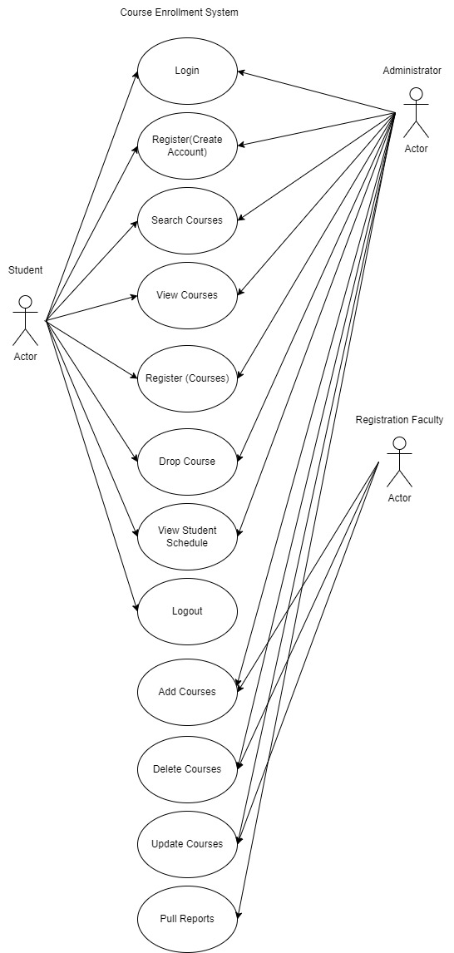
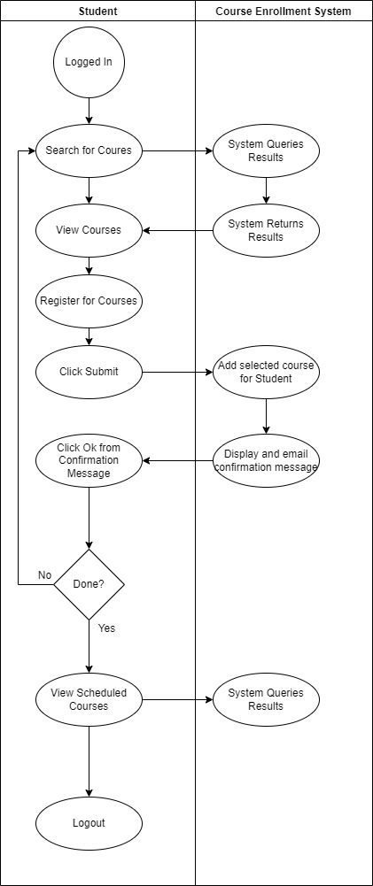
UML Designs
Use Case Diagram
Activity Diagram
Notes:
Unified modeling language

Slide 5
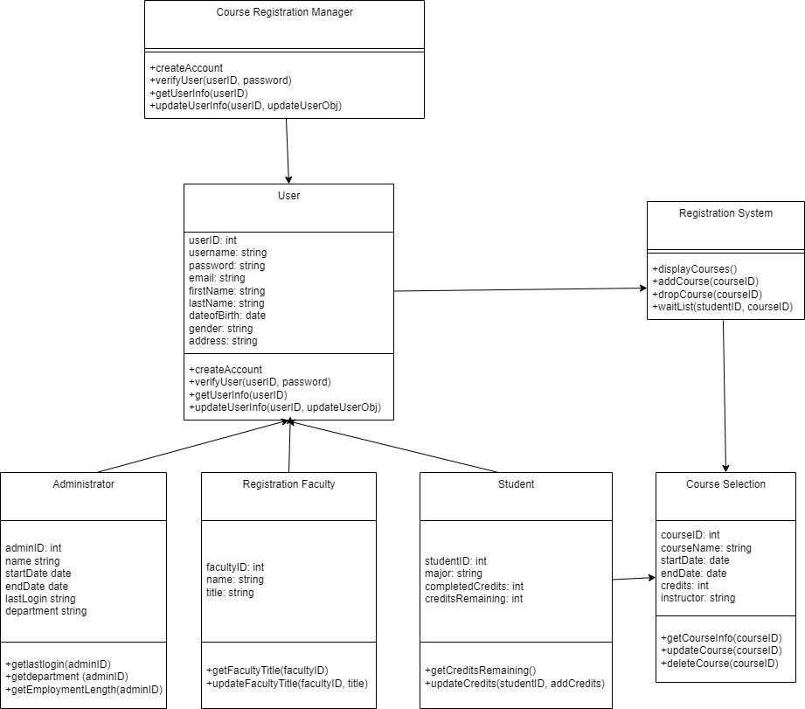
UML Designs
Class Diagram
Notes:
Relationship between each of the classes as well as attributes and methods (functions)

Slide 6
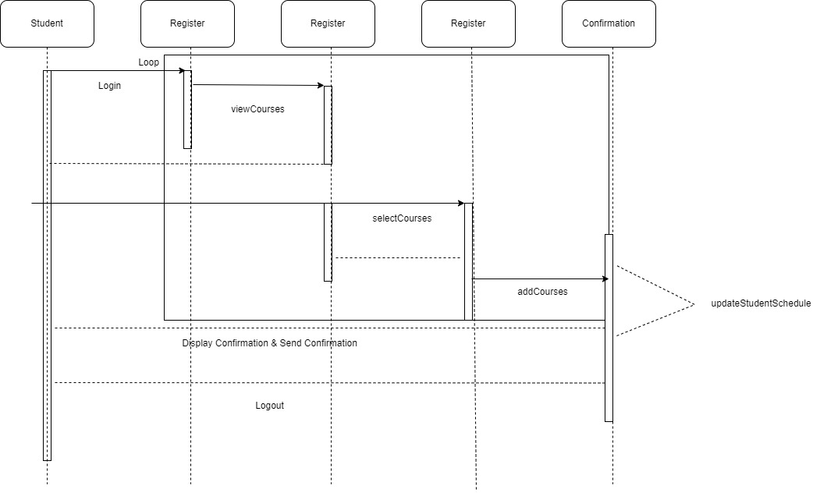
UML Designs
Sequence Diagram

Slide 7


Course Enrollment System

Slide 8
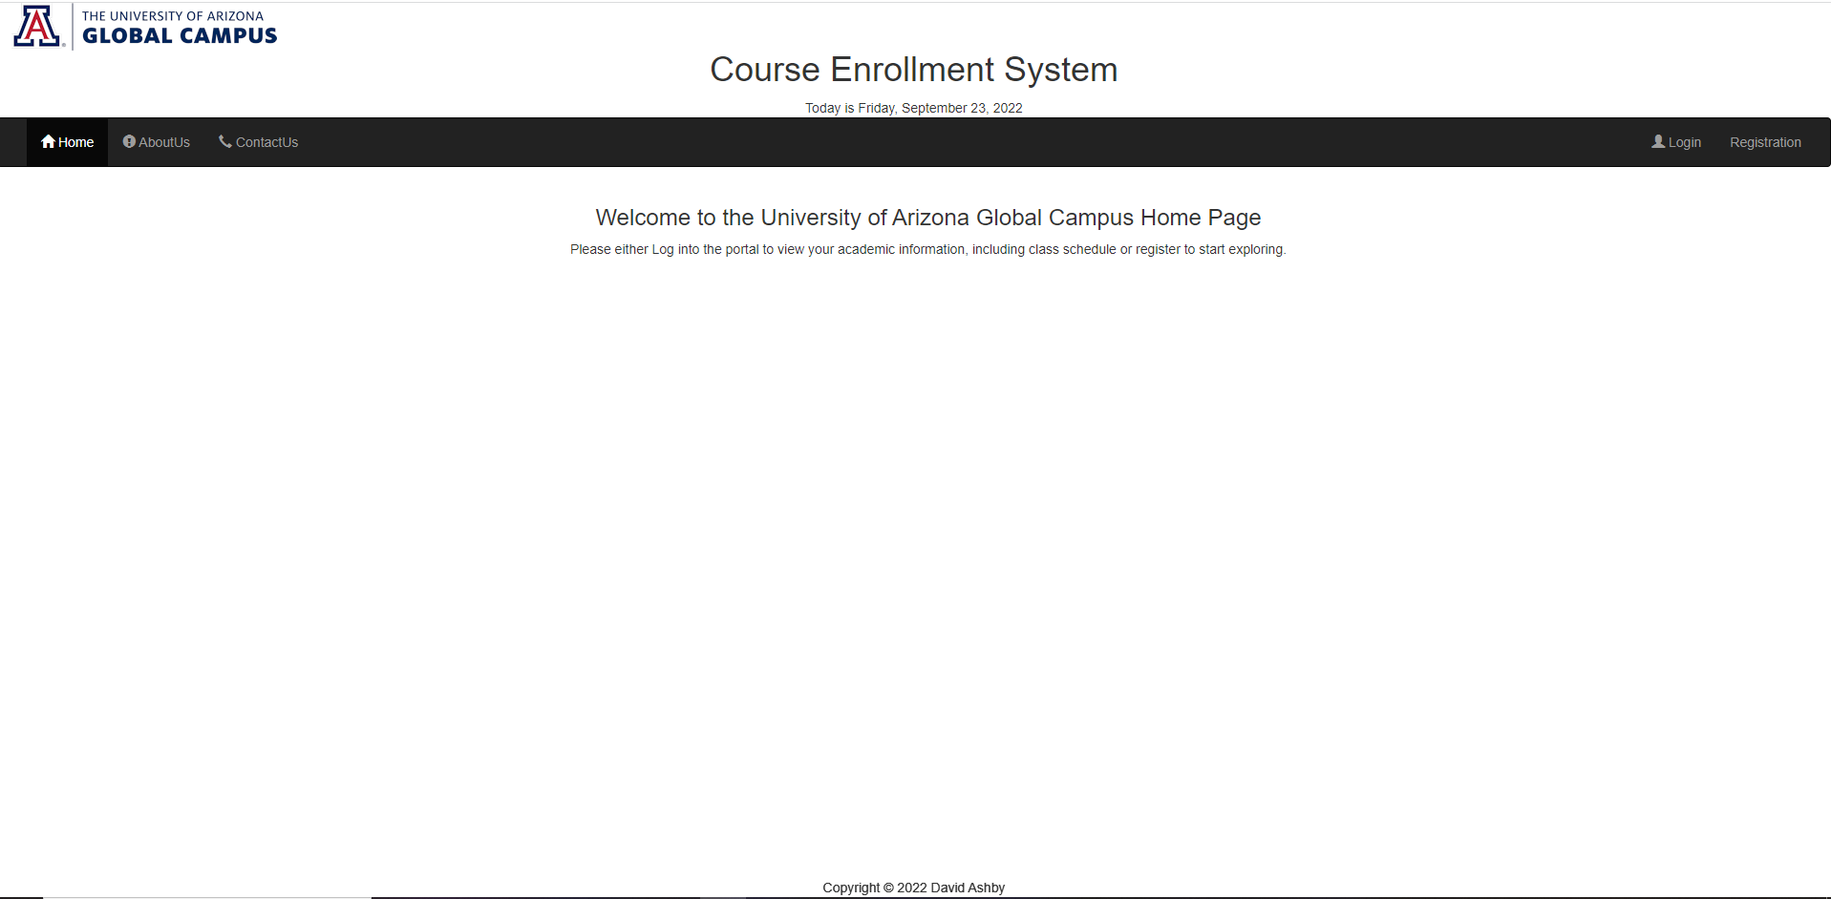
Landing (Home) Page

Slide 9
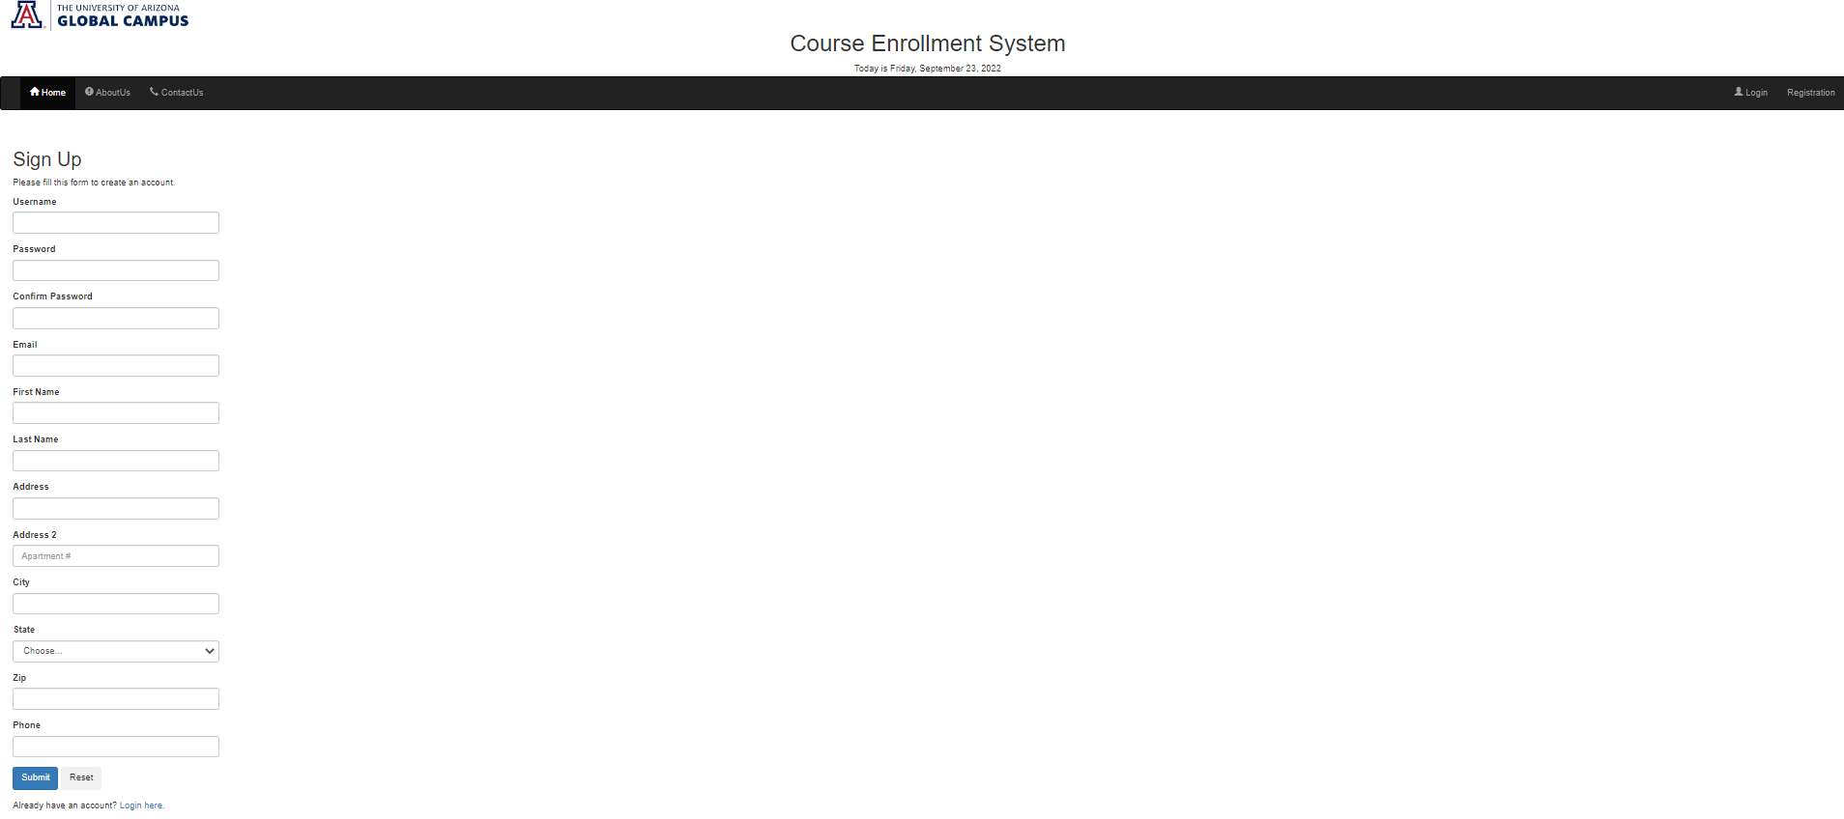
Registration Page

Slide 10
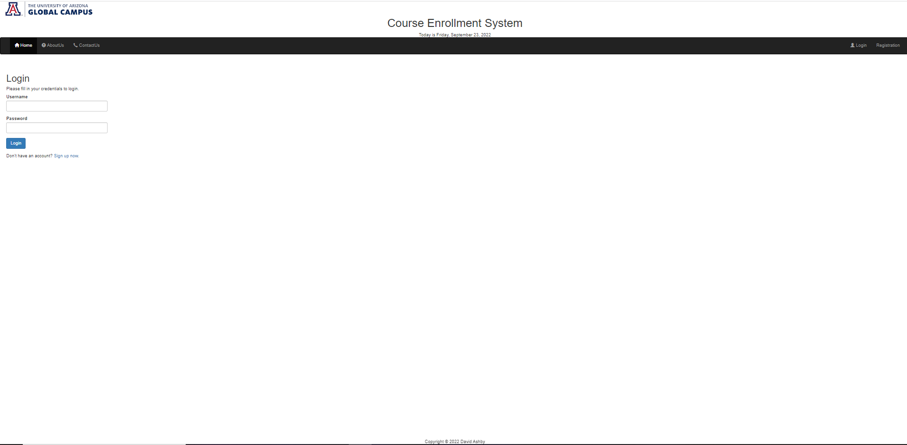
Login Page

Slide 11
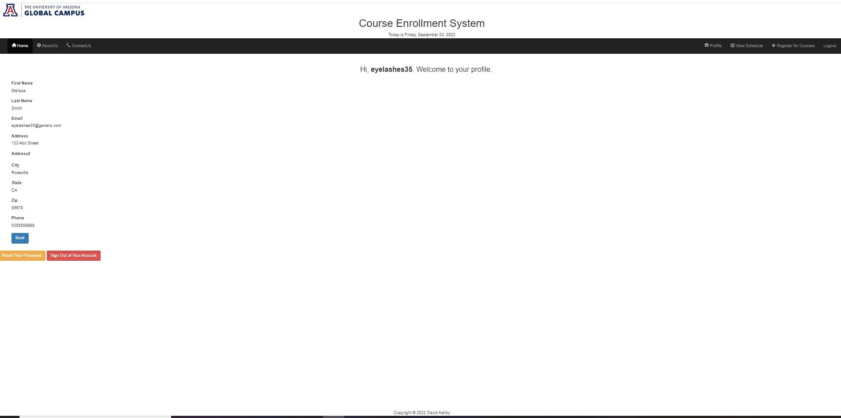
Profile Page

Slide 12
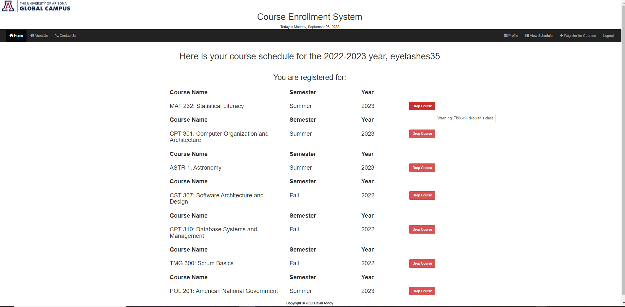
Course Schedule Page

Slide 13
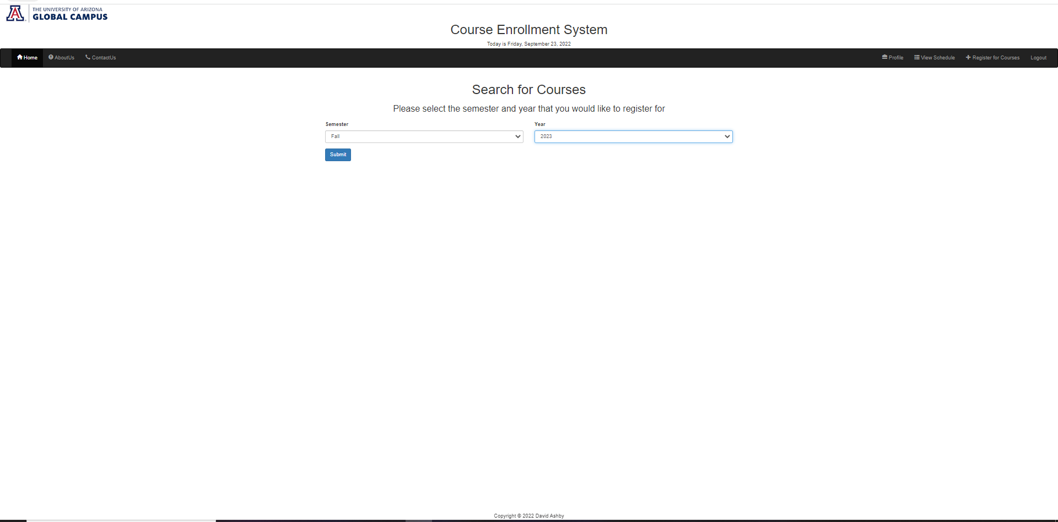
Search Courses Page

Slide 14
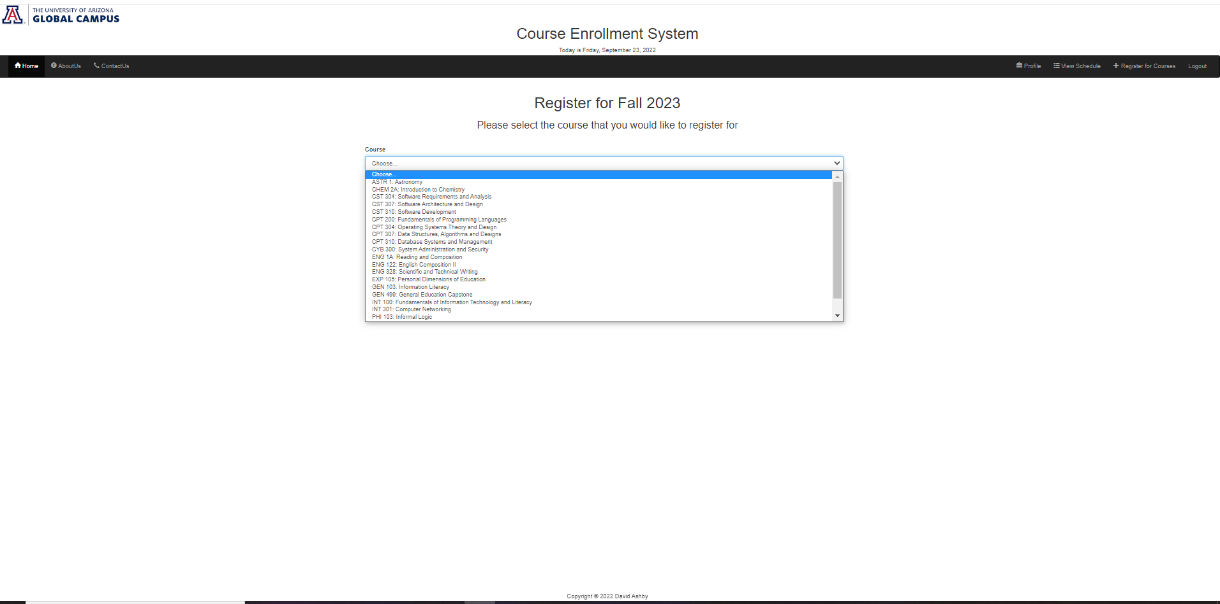
Register Course Page

Slide 15
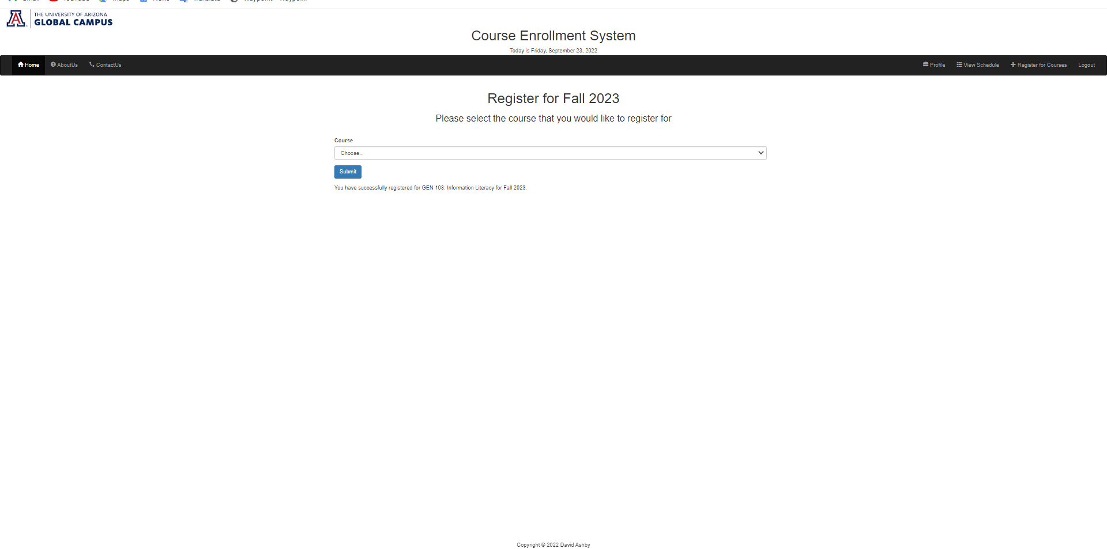
Register Course Page contd.

Slide 16
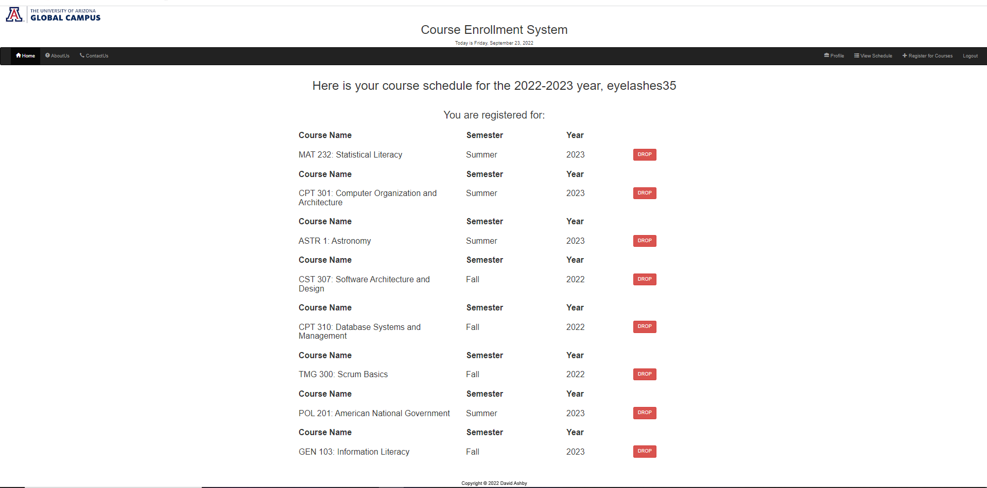
Course Schedule Page – Drop Course

Slide 17
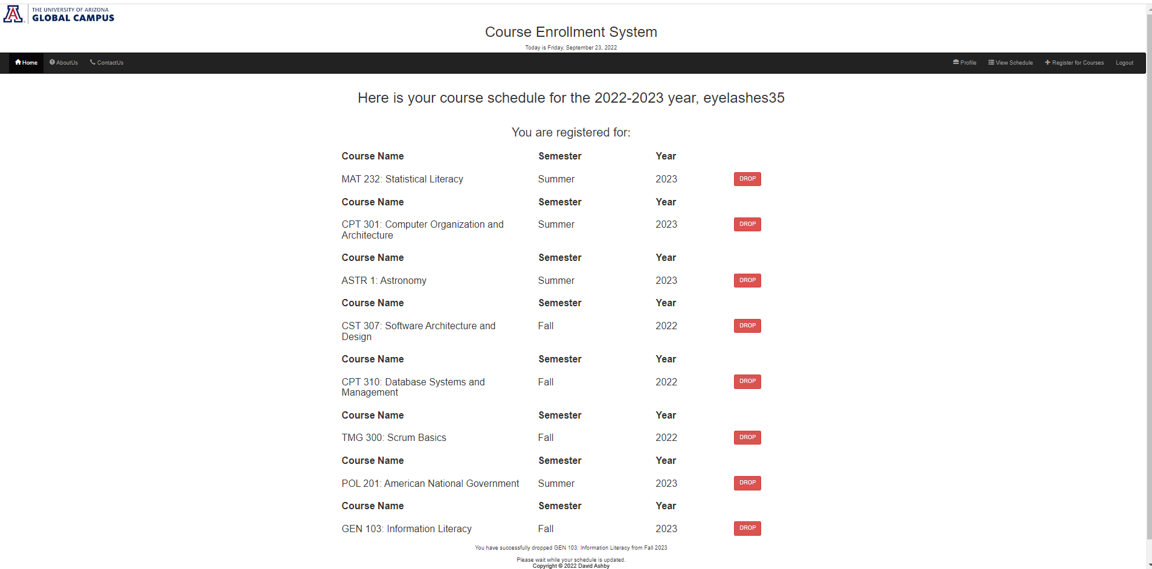
Course Schedule Page – Drop Course

Slide 18
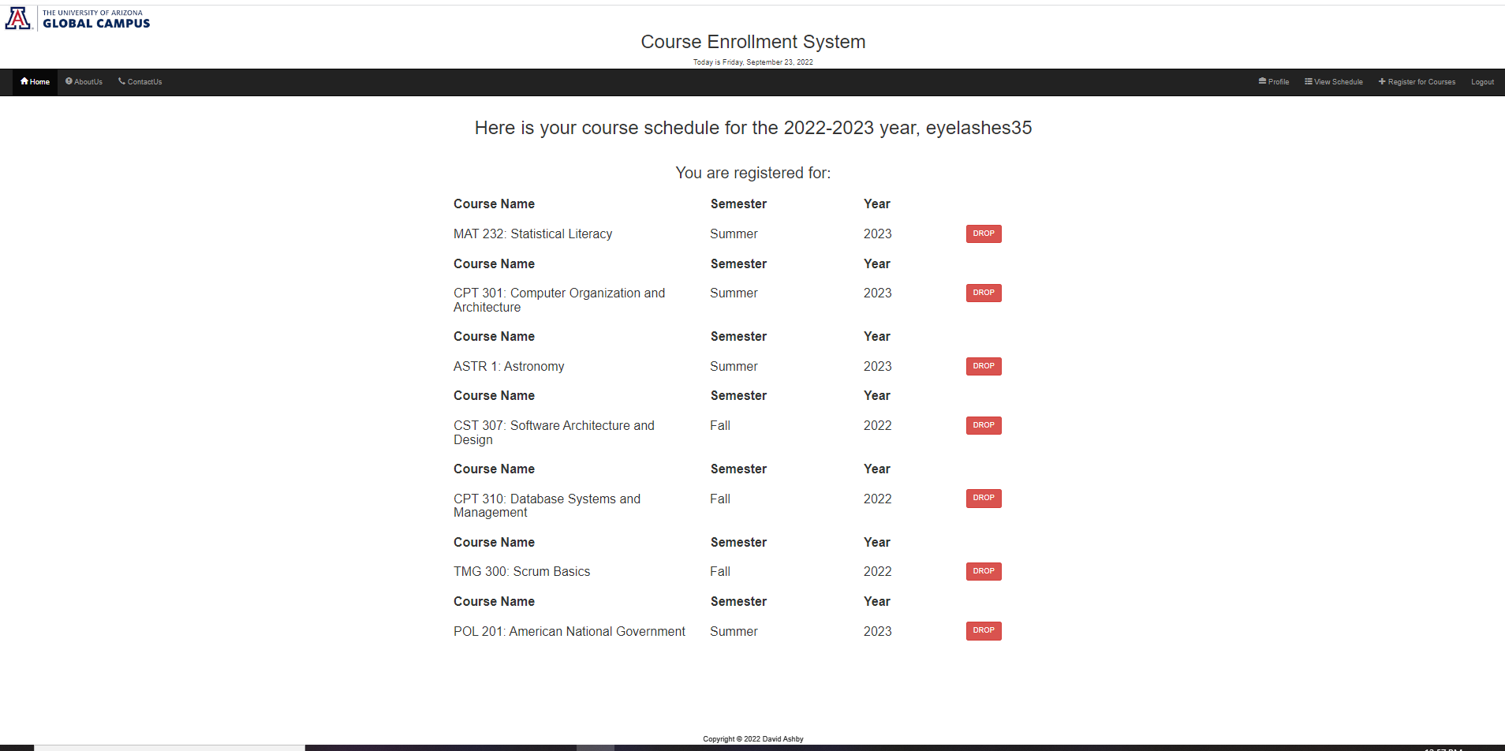
Course Schedule Page – Drop Course

Slide 19
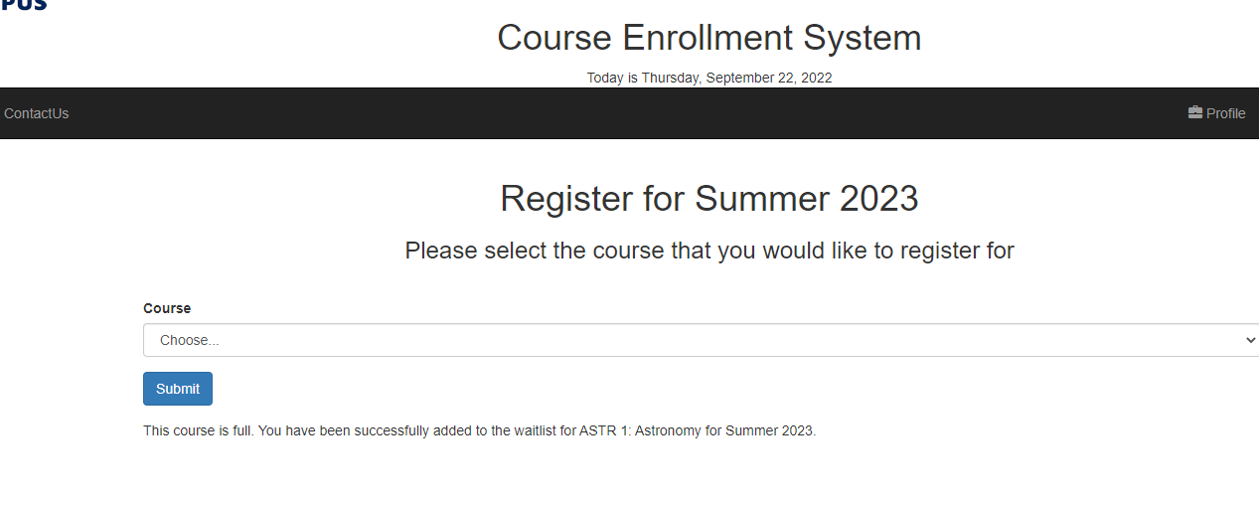
Waitlist

Slide 20
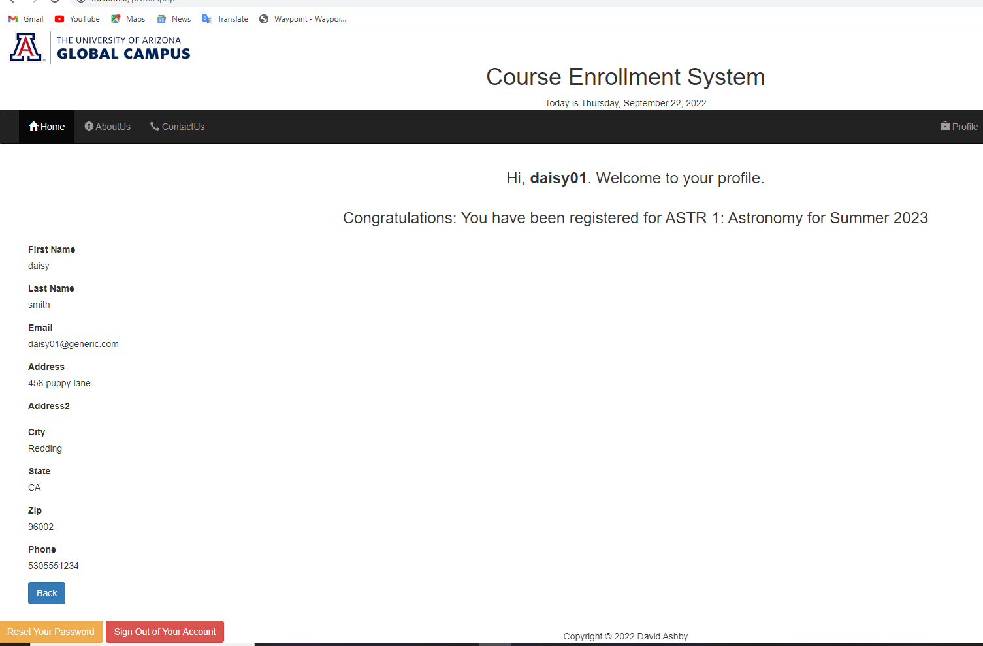
Notification

Slide 21
MySQL Database

Slide 22
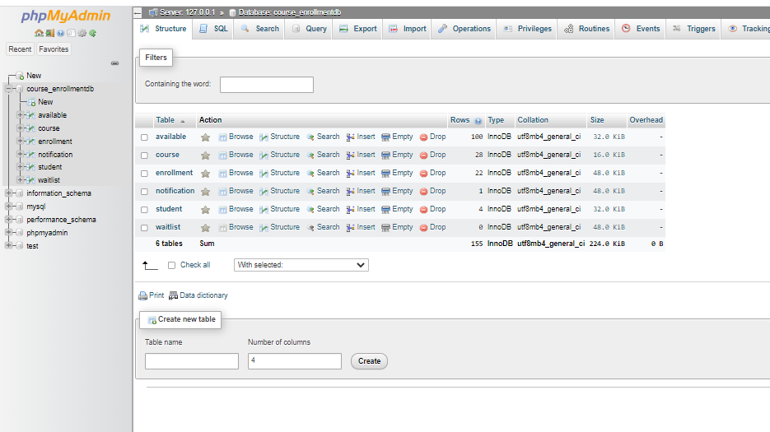
MySQL Database and Tables

Slide 23
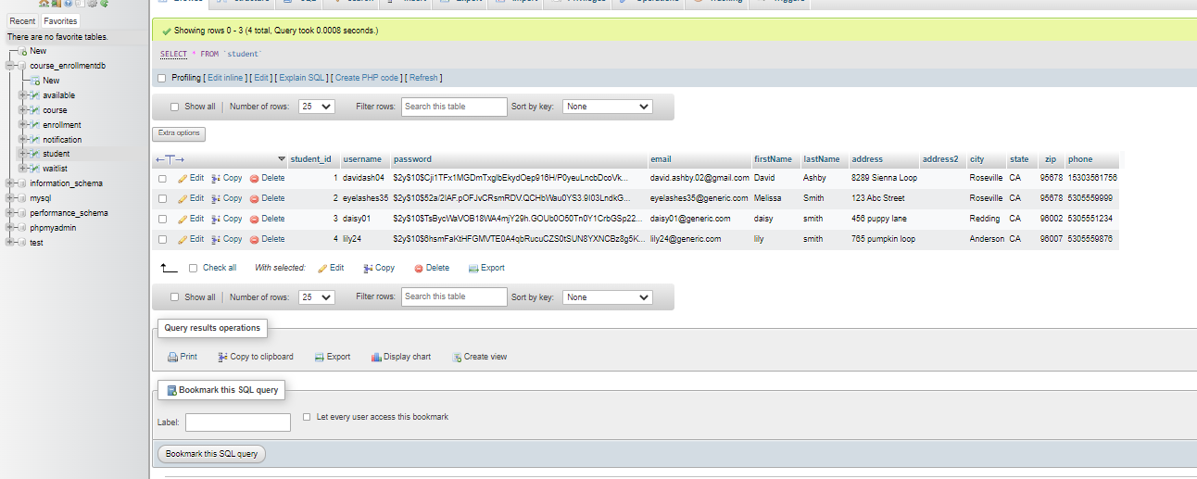
Student Table

Slide 24
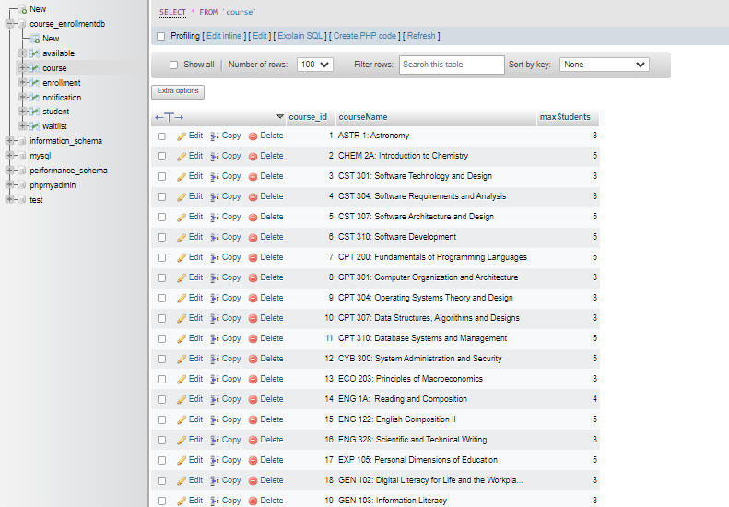
Course Table

Slide 25
Course Table

Slide 26
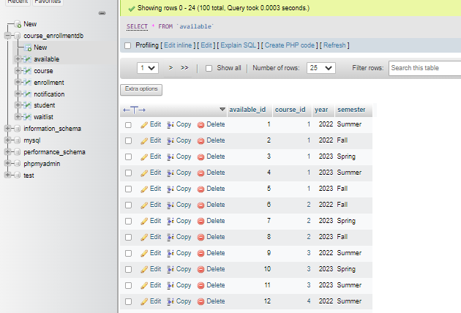
Available Table

Slide 27
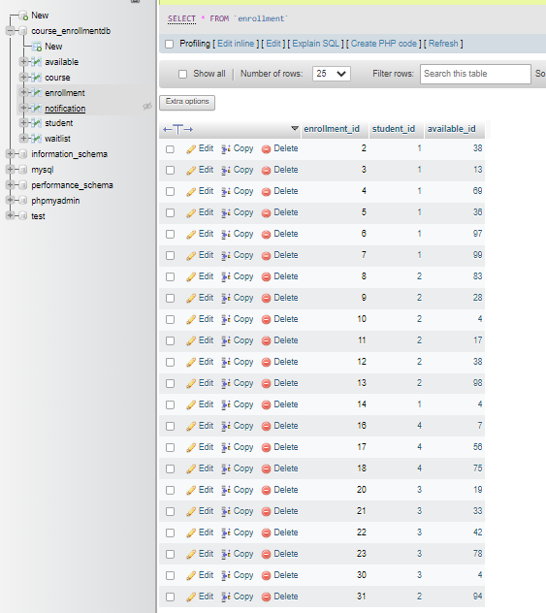
Enrollment Table

Slide 28
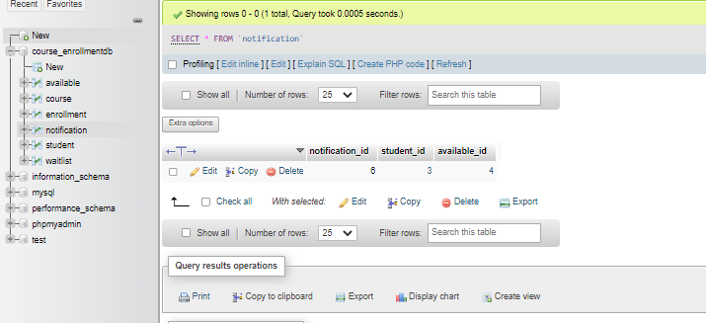
Notification Table

Slide 29
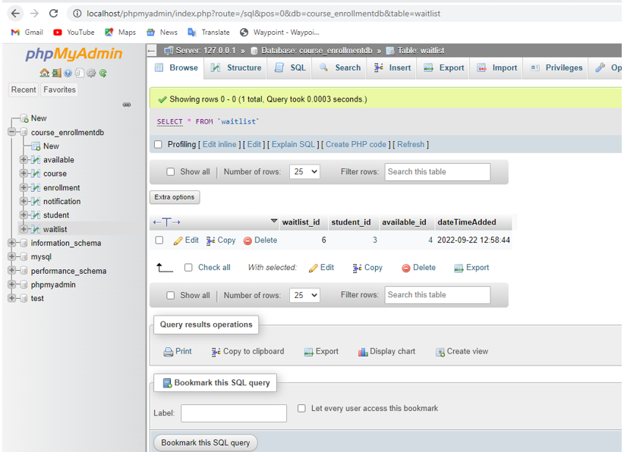
Waitlist Table

Slide 30
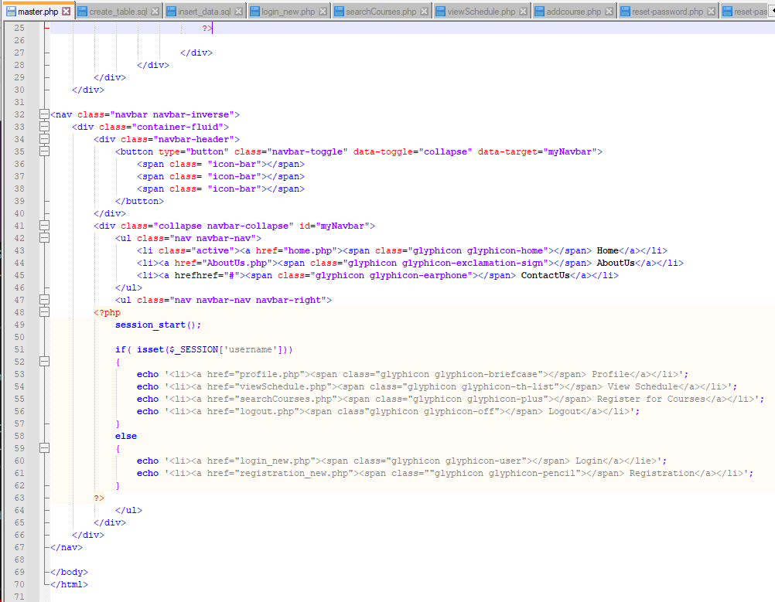
PHP Source Code

Slide 31
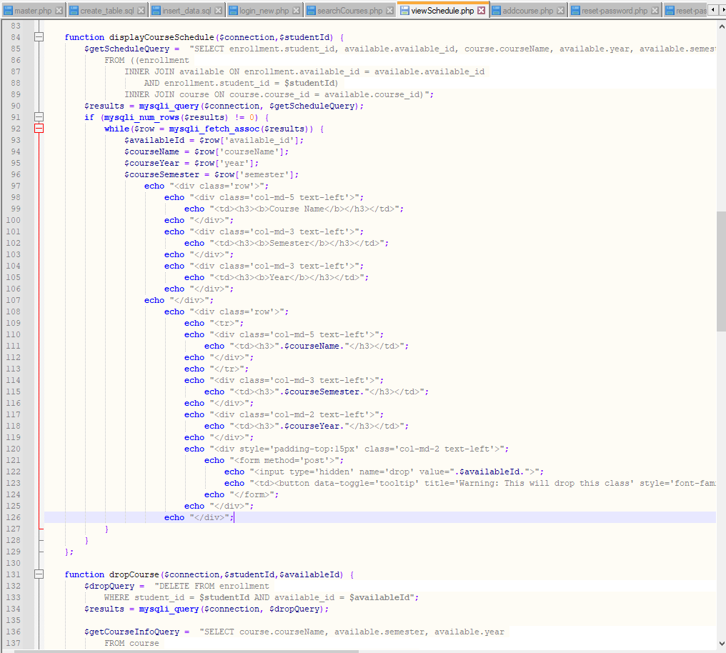
PHP Source Code
Notes:
1 of several functions, tried to keep this very simple and modular, along with readability for others

Slide 32
Thank you
David Ashby
https://github.com/dashby01

